Slide 1
Overview of OC’s Top Middle-Skill & Most Potential Opportunity Middle-Skill Jobs Presented by: OC Center of Excellence
Rancho Santiago Community College District’s Perkins V Advisory Council Meeting
May 31, 2022

Slide 2
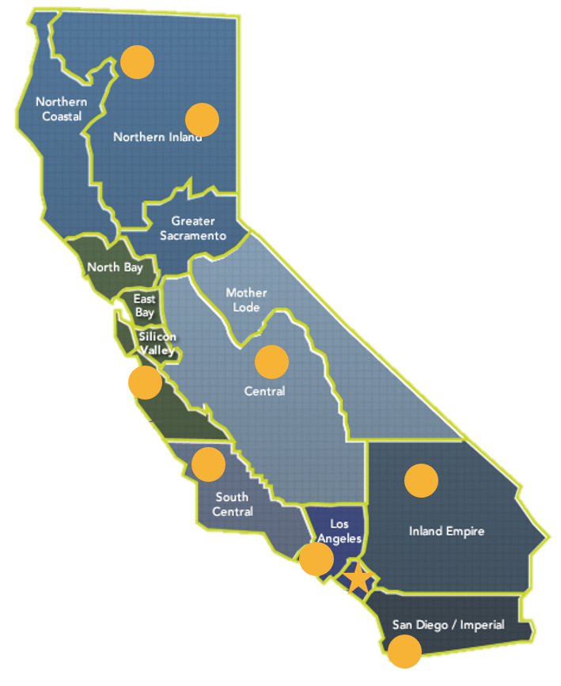
The COE & OC COE
The Centers of Excellence for Labor Market Research (COE) are the #1 source for labor market information for the California Community Colleges.
Notes:
https://coeccc.net/

Slide 3
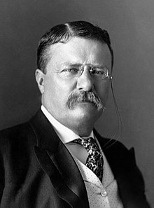
“We stand for a living wage. Wages are subnormal if they fail to provide a living for those who devote their time and energy to industrial occupations. The monetary equivalent of a living wage varies according to local conditions, but must include enough to secure the elements of a normal standard of living--a standard high enough to make morality possible, to provide for education and recreation, to care for immature members of the family, to maintain the family during periods of sickness, and to permit a reasonable saving for old age.”
-Theodore Roosevelt
1912 Presidential Candidate Campaign Speech (Progressive Party)
Notes:
26th President Republican (left-leaning). In office from Sept 14, 1901 (William McKinley’s assassination) to March 4, 1909 (age 42 – youngest president to date)
Decided not to run for a 3rd term then got frustrated with Taft’s “conservative politics” and ran in 1912 creating the Progressive Party.
https://www.loc.gov/collections/theodore-roosevelt-films/articles-and-essays/sound-recordings-of-theodore-roosevelts-voice/

Slide 4
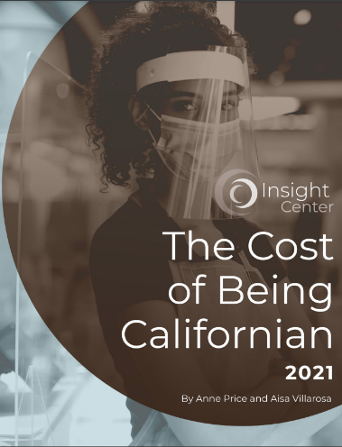
The Cost of Being Californian Report
“In 2020, the COVID-19 pandemic and resulting economic downturn magnified racial and gender inequities embedded in California’s economy.”
“Since 2018, the cost of living in southern and central portions of the state witnessed steep increases: Orange County (26%), Santa Barbara (40%), and Santa Cruz (45%).”
“Three years before the pandemic, the Insight Center’s 2018 Family Needs Calculator (FNC) determined that over one in three Californian households were not paid enough to meet their basic needs.”
Notes:
https://insightcced.org/cost-of-being-californian/
“Black and brown people and women of color experienced profound losses of health, community, income, and business at rates far more severe than white households. COVID-19 is not the root cause of these losses; the rules of our economy set by policymakers—which continue to favor the wealthy and predominantly white few, while simultaneously preventing Black and brown communities from reaching economic security—are responsible.”

Slide 5
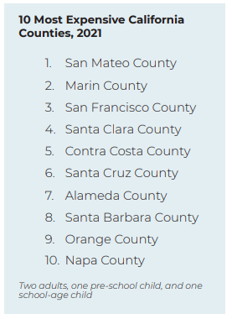
The Cost of Being Californian Report
“The cost of living varies widely within California, and the Bay Area remains one of the most expensive regions in both the state and the nation.”
“Since 2018, the cost of living has increased at various rates among counties in California. Some of the most expensive places to live in the state saw a rise in cost of basic household expenses… …Orange County 26%...”
Notes:
https://insightcced.org/wp-content/uploads/2021/05/INSIGHT_CostofBeingCalifornian_6_web.pdf p. 7
“The hourly wage needed for a family with one parent, one preschooler, and one schoolage child to meet their basic household expenses ranges from $26.32 and $27.53 an hour in Modoc and Plumas (two small counties in the northeastern part of the state), respectively, to an astonishing $74.60 and $73.28 an hour in the Bay Area counties of San Mateo and Marin.”

Slide 6
Self-Sufficiency Standard
The University of Washington’s School of Social Work Center for Women’s Welfare Self-Sufficiency Standard defines the income working families need to meet a minimum yet adequate level, taking into account family composition, ages of children, and geographic differences in costs*. The Standard is an affordability and living wage economic security measure that provides an alternative to the official poverty measure.
*See the “Technical Brief” for specific data elements and sources
Notes:
http://www.selfsufficiencystandard.org/california/
The Self-Sufficiency Standard, known as the Family Needs Calculator for California 2021. This measure calculates how much income a family must earn to meet basic needs, with the amount varying by family composition and county. The Family Needs Calculator for California 2021 is the ninth calculation of the Self-Sufficiency Standard data.
http://www.selfsufficiencystandard.org/wp-content/uploads/2021/12/CA2021_TechnicalAppendix.pdf

Slide 7
Family Needs Calculator
Launched in 1996 the Insight Center’s Family Needs Calculator measures the floor income necessary for an individual (under age 65 and without disability) or family to afford basic expenses in California. Covering all 58 counties, the data assesses the cost of housing, food, child care, health care, transportation, and taxes—without accounting for public or private assistance.
Notes:
https://insightcced.org/family-needs-calculator/
ANOTHER LIVING WAGE CALCULATOR: MIT Living Wage Calculator
“The living wage shown is the hourly rate that an individual in a household must earn to support his or herself and their family. The assumption is the sole provider is working full-time (2080 hours per year). The tool provides information for individuals, and households with one or two working adults and zero to three children. In the case of households with two working adults, all values are per working adult, single or in a family unless otherwise noted.” -MIT Living Wage Calculation for Orange County, CA
https://livingwage.mit.edu/counties/06059

Slide 8
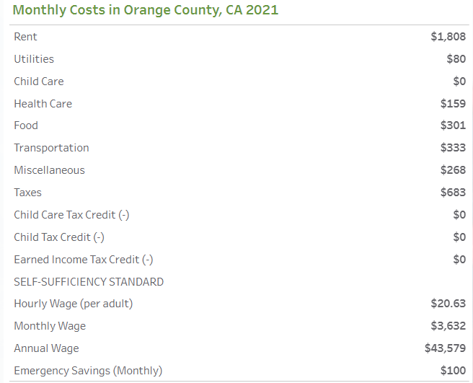
Family Needs Calculator
Notes:
https://insightcced.org/family-needs-calculator/

Slide 9
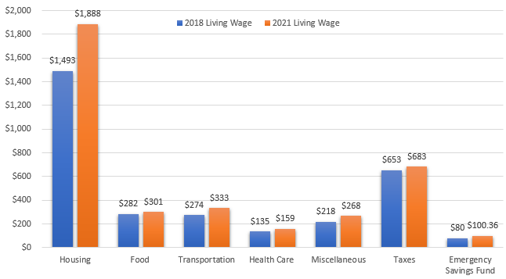
OC Living Wage: 2018 vs. 2021
Notes:
2018 = $17.36/hr
2021 = $20.63/hr ($3.27 change)
Housing: Assumes one-bedroom unit. Utilities.
Food: USDA low-cost food plan for food costs.
Transportation: Assumes private transportation, as OC does not have a high percentage of workers that commute via public transit. One car is assumed - estimates include gas and auto insurance.
Health Care: Health insurance premiums, out-of-pocket costs. Note: assumes employer-sponsored health coverage, which not all people have.
Miscellaneous: Clothing, shoes, cleaning products, personal hygiene items, phone service
Taxes: Income and payroll taxes
https://insightcced.org/family-needs-calculator/

Slide 10
Notes:
What is the OC COE?
What is the OC Sector Analysis Project?
In-Demand Industry Sectors and Occupations

Slide 11
OC Sector Analysis Project
Identify OC’s middle-skill labor supply gaps and how to fill said gaps
Discuss college and regional challenges & learn from each other
Study Data Collection Methodology
Labor Market Info – Quantitative Data
8 OC Community College Priority Sectors
Advanced Transportation & Logistics
Business & Entrepreneurship
Energy, Construction, & Utilities
Health
ICT/Digital Media
Retail, Hospitality, & Tourism
Advanced Manufacturing
Life Sciences & Biotechnology
Focus Groups - Qualitative Data
12 Focus Groups
Faculty, Administrators, & Regional/State Directors for Employer Engagement
Notes:
Top Middle-Skill (above Living Wage ($20.63) and Most Potential Opportunity Middle-Skill occupations (below LW)
COE Middle-Skill Jobs Definition:
All occupations that require an educational requirement of some college, associate degree or apprenticeship, but not a bachelor’s degree;
All occupations that require a bachelor’s degree, but also have more than 1/3 of their existing labor force with an educational attainment of some college or associate degree; or
All occupations that require a high school diploma or equivalent or no formal education, but also require short- to long-term on-the-job training where multiple community colleges have existing programs.
https://coeccc.net/collection/orange-county-ocsap-2021/

Slide 12
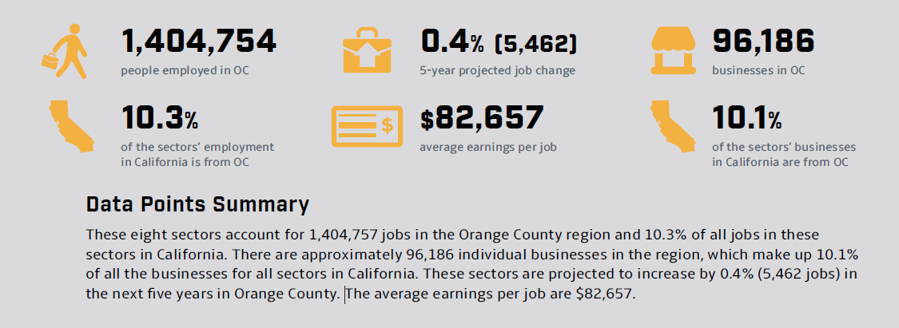
OCSAP 2021 Data Points
Notes:
https://coeccc.net/collection/orange-county-ocsap-2021/

Slide 13
Notes:
https://coeccc.net/collection/orange-county-ocsap-2021/

Slide 14
OCSAP 2021 Data Refresh
Current labor market data analyzed in November 2021
Post-COVID-19 recession
Accounts for changes to federal SOC and CIP systems
Living wage increased from $17.39 to $20.63
Due to these changes, some of OCSAP’s 2021 occupations differ from its 2019 occupations
Notes:
https://coeccc.net/collection/orange-county-ocsap-2021/

Slide 15
OCSAP 2019 vs. 2021 Changes
2019 Occupations | 2021 Occupations
113 occupations did not change in 2021 16 have a different SOC code or title 12 now have fewer than 50 annual job openings 3 are no longer considered middle-skill 1 does not fall within a priority sector *32 occupations from the 2019 report are not in the 2021 refresh. | 113 occupations did not change from 2019 17 have a different or new SOC code or title 8 now have at least 50 annual job openings 6 moved from unassigned to priority sector 5 are now considered middle-skill 3 are now included in the COE Crosswalk *39 occupations from the 2021 refresh are not in the 2019 report
Notes:
New SOC Code or Title Count by Sector:
ICT and Digital Media: 6
Health: 4
Advanced Manufacturing: 2
Advanced Transportation and Logistics: 2
Business and Ent: 2
Retail, Hospitality, and Tourism: 1

Slide 16
OCSAP 2019 v. 2021
Description | 2019 | 2021
Demand Time Period | 2018-2023 | 2020-2025
Supply Time Period | 2015-2017 | 2017-2020
Living Wage | $17.39 | $20.63
Average Entry-Level Wage | $18.69 | $20.36
# of Occupations | 145 | 152
# of Top Middle-Skill Occupations | 75 | 56
# of Most Potential Opportunity Occupations | 70 | 96
Notes:
https://coeccc.net/collection/orange-county-ocsap-2021/
Of the 145 occupations in the 2019 version, 109 (75%) remained either top middle-skill or most potential opportunity occupations, 18 (12%) moved from top middle-skill to most potential opportunity, 1 (.01%) moved from most potential opportunity to top middle-skill, and 17 (11%) were not included in the 2021 update.

Slide 17
Notes:
https://coeccc.net/collection/orange-county-ocsap-2021/

Slide 18
Executive Summary: Top Middle-Skill Jobs – All Sectors
Demand:
16,896
Supply:
11,860
Labor Supply Gap:
5,216
Notes:
https://coeccc.net/collection/orange-county-ocsap-2021/
* indicates that the sector has an oversupply of labor, ^ indicates that this sector’s demand has been met, and N/A indicates that no community college program reported awards for this sector or no community college program is available for this sector.

Slide 19
Executive Summary: Most Potential Opportunity Middle-Skill Jobs – All Sectors
Demand:
49,487
Supply:
9,789
Labor Supply Gap:
39,698
Notes:
https://coeccc.net/collection/orange-county-ocsap-2021/
* indicates that the sector has an oversupply of labor, ^ indicates that this sector’s demand has been met, and N/A indicates that no community college program reported awards for this sector or no community college program is available for this sector.

Slide 20
Notes:
https://coeccc.net/collection/orange-county-ocsap-2021/

Slide 21
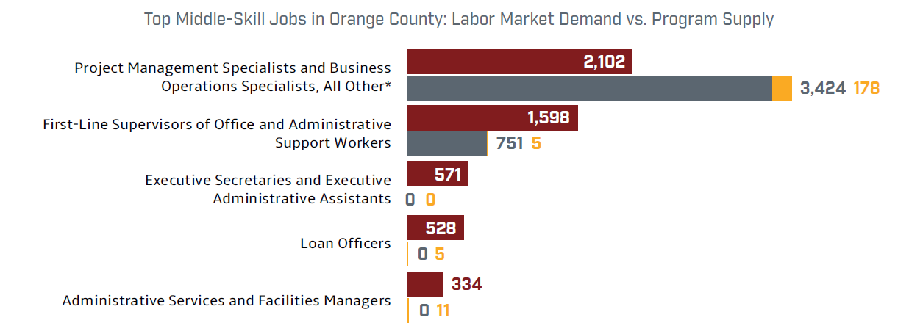
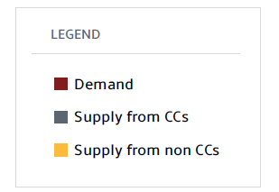
Business and Entrepreneurship
Labor Supply Gap:
14,946
Notes:
https://coeccc.net/collection/orange-county-ocsap-2021
* indicates that the occupation has an oversupply of labor, ^ indicates that this occupation’s demand has been met, and N/A indicates that no community college program reported awards for this occupation or no community college program is available for this occupation.
/

Slide 22
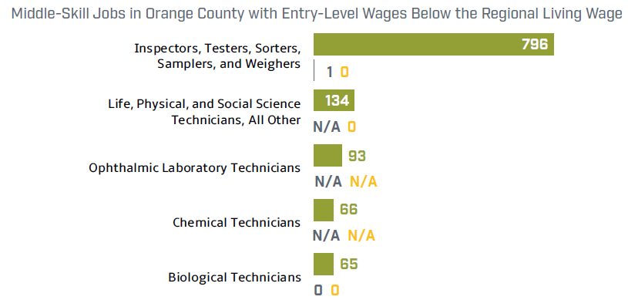
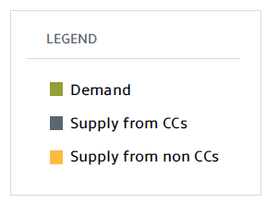
Life Sciences and Biotechnology
Labor Supply Gap:
1,244
Notes:
https://coeccc.net/collection/orange-county-ocsap-2021/
* indicates that the occupation has an oversupply of labor, ^ indicates that this occupation’s demand has been met, and N/A indicates that no community college program reported awards for this occupation or no community college program is available for this occupation.

Slide 23
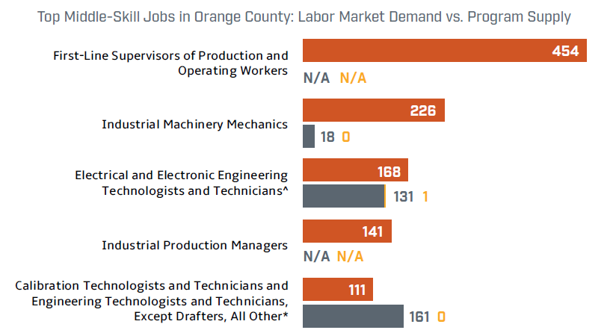
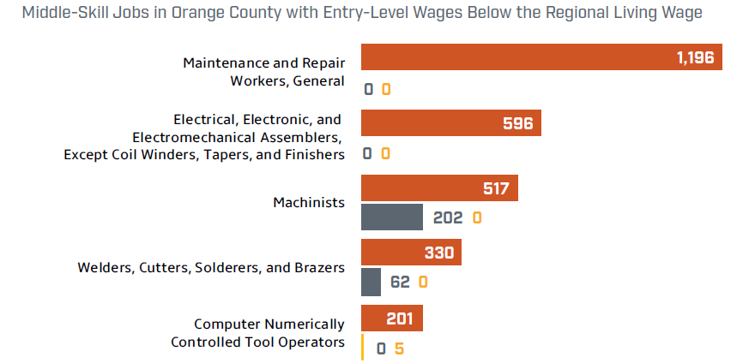
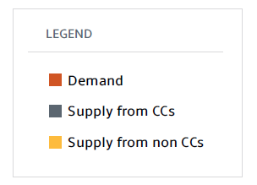
Advanced Manufacturing
Labor Supply Gap:
3,912
Notes:
https://coeccc.net/collection/orange-county-ocsap-2021/
* indicates that the occupation has an oversupply of labor, ^ indicates that this occupation’s demand has been met, and N/A indicates that no community college program reported awards for this occupation or no community college program is available for this occupation.

Slide 24
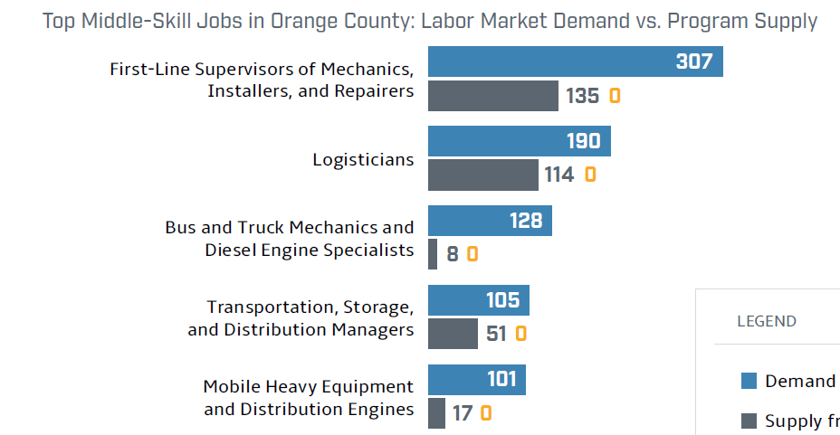
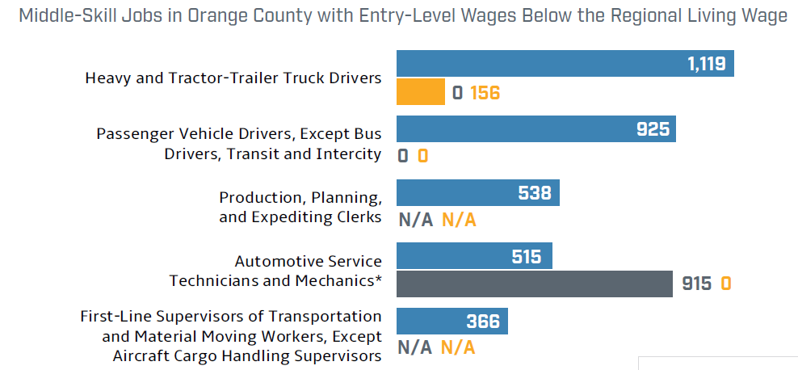
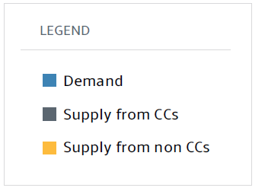
Advanced Transportation and Logistics
Labor Supply Gap:
3,166
Notes:
https://coeccc.net/collection/orange-county-ocsap-2021/
* indicates that the occupation has an oversupply of labor, ^ indicates that this occupation’s demand has been met, and N/A indicates that no community college program reported awards for this occupation or no community college program is available for this occupation.
Supply for Automotive Service Technicians and Mechanics is overstated due to the automatic conferral of low-unit, local certificates by Santa Ana College in 2017-18.

Slide 25
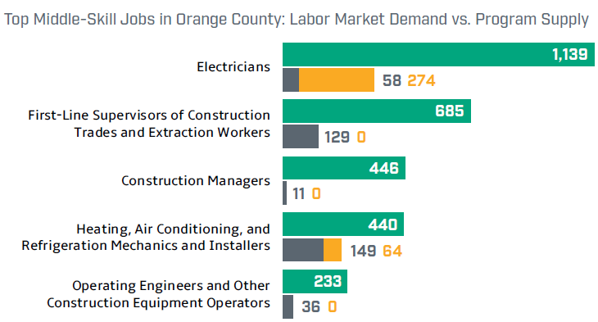
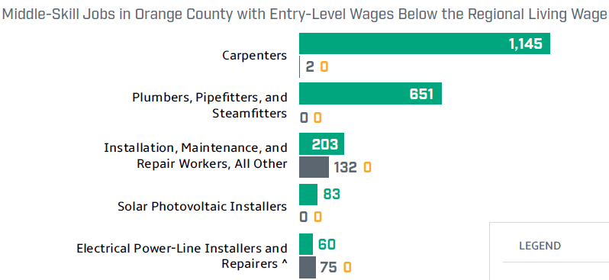
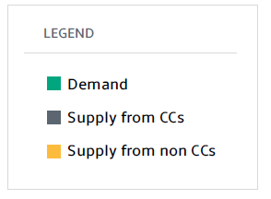
Energy, Construction, and Utilities
Labor Supply Gap:
4,585
Notes:
https://coeccc.net/collection/orange-county-ocsap-2021/
* indicates that the occupation has an oversupply of labor, ^ indicates that this occupation’s demand has been met, and N/A indicates that no community college program reported awards for this occupation or no community college program is available for this occupation.

Slide 26
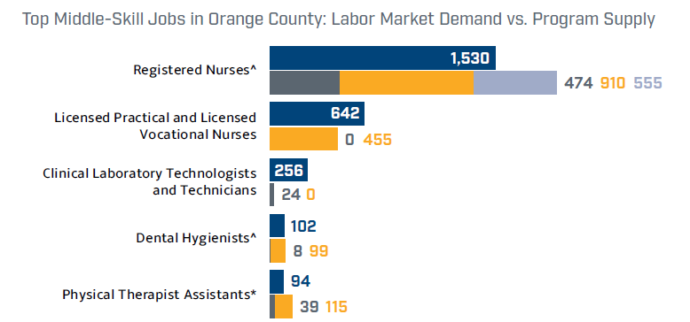
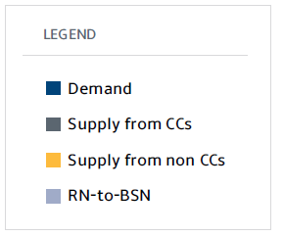
Health
Labor Supply Gap:
12,997
Notes:
https://coeccc.net/collection/orange-county-ocsap-2021/
* indicates that the occupation has an oversupply of labor, ^ indicates that this occupation’s demand has been met, and N/A indicates that no community college program reported awards for this occupation or no community college program is available for this occupation.

Slide 27
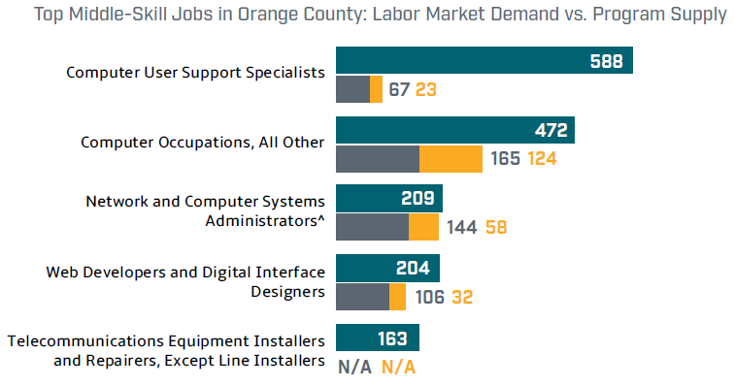
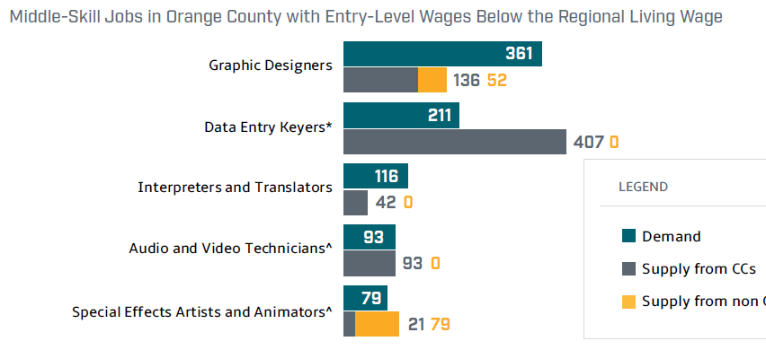
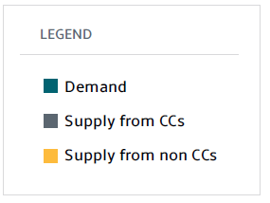
ICT and Digital Media
Labor Supply Gap:
93
Notes:
https://coeccc.net/collection/orange-county-ocsap-2021/
indicates that the occupation has an oversupply of labor, ^ indicates that this occupation’s demand has been met, and N/A indicates that no community college program reported awards for this occupation or no community college program is available for this occupation.
When comparing the ICT vs. Digital Media jobs, there is an undersupply for ICT but an oversupply for Digital Media:
ICT Gap: 555 awards = 2,020 Openings - 1,462 awards
Digital Media Gap: -465 awards = 917 openings – 1,382 awards

Slide 28
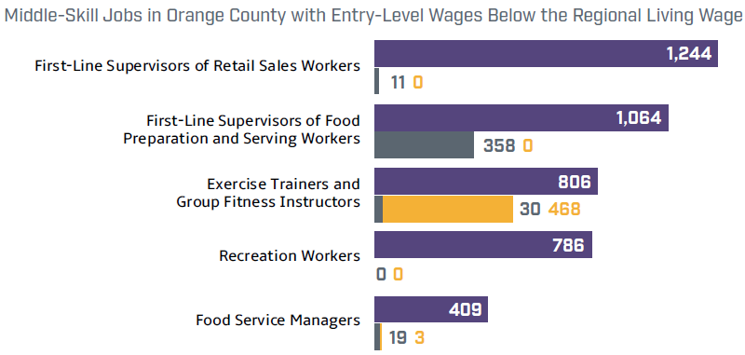
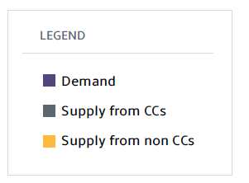
Retail, Hospitality, and Tourism
Labor Supply Gap:
4,061
Notes:
https://coeccc.net/collection/orange-county-ocsap-2021/
* indicates that the occupation has an oversupply of labor, ^ indicates that this occupation’s demand has been met, and N/A indicates that no community college program reported awards for this occupation or no community college program is available for this occupation.

Slide 29
Notes:
https://coeccc.net/collection/orange-county-ocsap-2021/

Slide 30
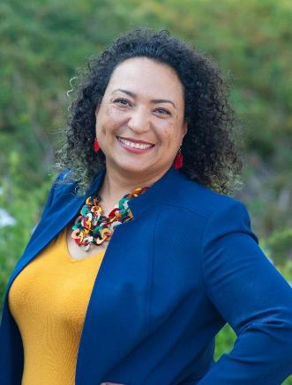
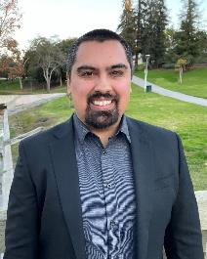
OC Center of Excellence
Jesse Crete, Ed.D.
Orange County COE Director
crete_jesse@rsccd.edu
Jacob Poore
Orange County COE Research Analyst
poore_jacob@rsccd.edu
coeccc.net
OC Sector Analysis Project 2021: Briefs & Profiles
Notes:
coeccc.net
https://coeccc.net/collection/orange-county-ocsap-2021/

